Slide 1
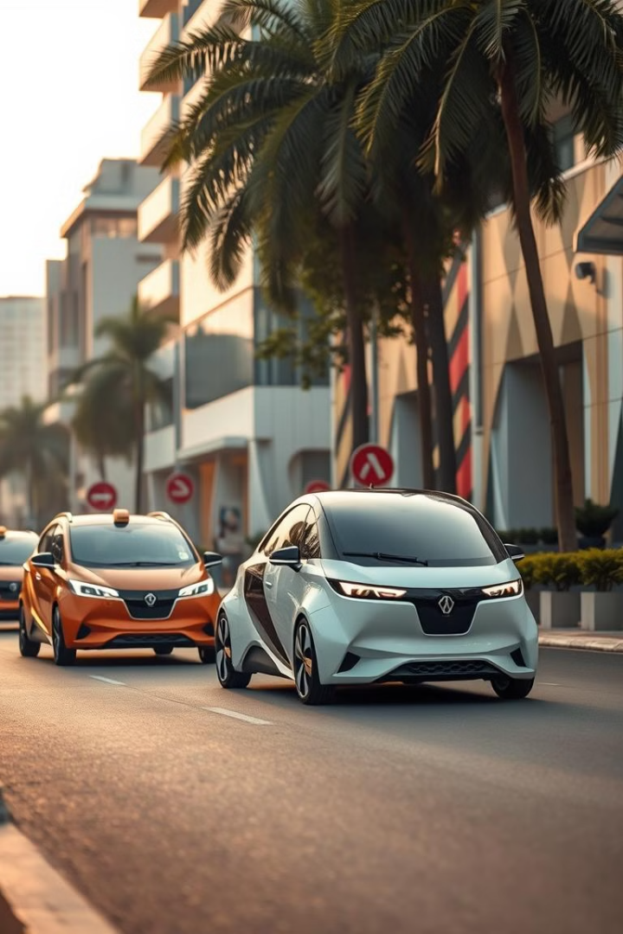
Investing in India's Electric Vehicle Sector
India's Electric Vehicle (EV) sector presents a compelling investment opportunity, driven by robust growth prospects, supportive government policies, and a shift towards sustainable transportation. This analysis explores the current state, future projections, key players, emerging trends, and investment potential of India's EV market.

Slide 2
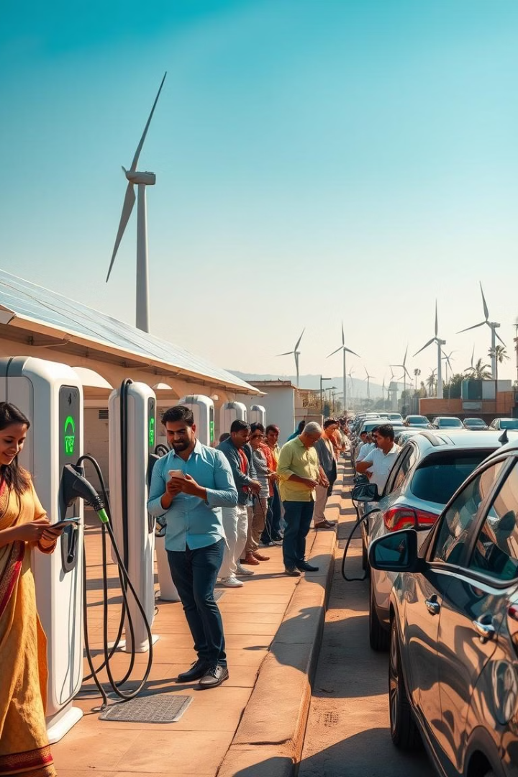
Why Electric Vehicles?
1
Environmental Imperatives
EVs offer a sustainable alternative to traditional internal combustion engine vehicles, reducing greenhouse gas emissions and air pollution—a critical concern in India.
2
Energy Security
Transitioning to EVs decreases reliance on imported fossil fuels, enhancing national energy security.
3
Economic Growth
The EV sector is poised to create significant employment opportunities and stimulate technological advancements.

Slide 3
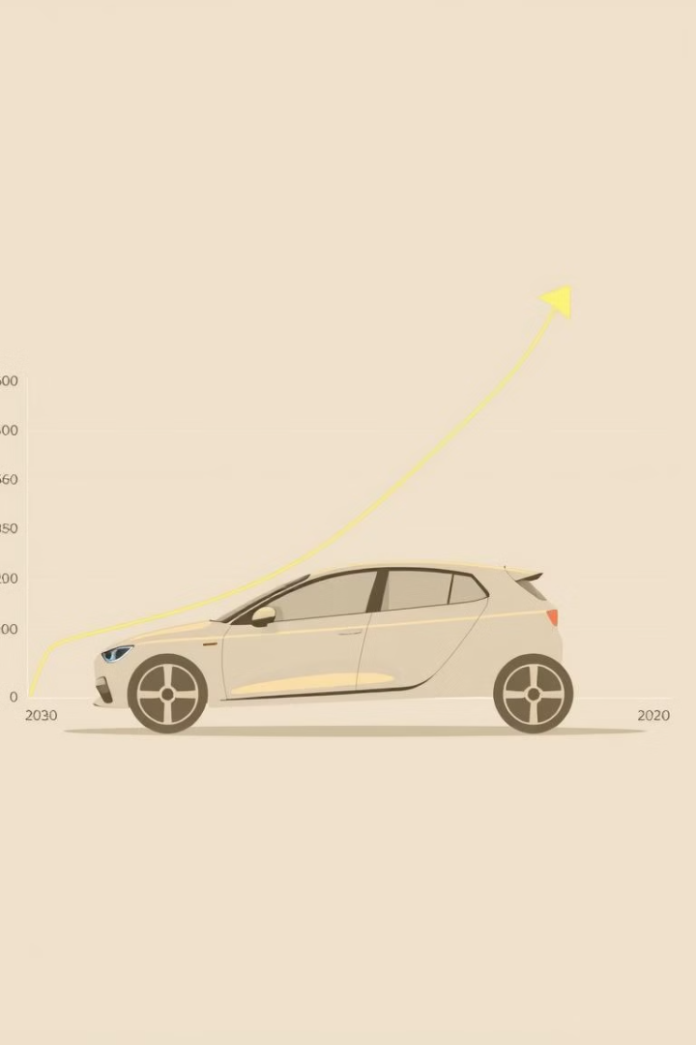
Sector Analysis: Historical Perspective and Projections
1
Historical Growth
India's EV market has experienced substantial growth, with sales surging 42% to 1.67 million units in FY2024, encompassing two-wheelers, three-wheelers, cars, and SUVs.
2
Current State
EVs currently constitute approximately 5% of total vehicle sales in India.
3
Projections to 2030
The market is expected to grow at a compound annual growth rate (CAGR) of 49% between 2022 and 2030, aiming for annual sales of 10 million units by 2030.

Slide 4
Market Size and Share Analysis
Market Size
Segment Distribution
Passenger Vehicles
The Indian EV market is projected to reach USD 34.8 billion in 2024 and USD 120 billion by 2030, growing at a CAGR of 22.92% during the forecast period.
Two-wheelers dominate the EV market, accounting for over 80% of total EV sales by FY2030.
Electric cars are gaining traction, with sales expected to reach 430,603 units by 2030, growing at a CAGR of 56% from 2024.

Slide 5

Key Players in the EV Sector
Company
Key Information
Tata Motors
Leading the market with a range of electric cars and plans to launch 10 electric models by 2025.
Mahindra & Mahindra
Targeting 20-30% of SUV sales from EVs by March 2027.
Ola Electric
A significant player in the electric two-wheeler segment.
MG Motor India
Aiming to sell one million EVs in India by 2030 through a joint venture with JSW Group.
BYD
Expanding its presence with models like the e6 MPV and Atto 3 SUV.

Slide 6





Emerging Trends and Key Drivers
Battery Swapping
Local Manufacturing
Technological Advancements
Government Initiatives
Gaining traction, especially for two- and three-wheelers, to address charging infrastructure challenges.
Policies incentivizing domestic production are attracting investments from global players.
Developments in battery technology and charging infrastructure are enhancing EV adoption.
Schemes like FAME II and state-level subsidies are accelerating EV adoption.

Slide 7

Future Outlook in India and Overseas
India's Outlook
With supportive policies, technological advancements, and increasing consumer acceptance, the EV sector is poised for exponential growth, aiming for 30% of new vehicle sales to be electric by 2030.
Global Perspective
India's EV market is becoming a focal point for international manufacturers seeking growth opportunities, with collaborations and investments on the rise.
Investment Potential
The Indian EV sector offers a promising investment landscape, underpinned by strong growth trajectories, supportive government policies, and a shift towards sustainable transportation solutions.

Slide 8




Key Publicly Traded Companies Analysis
Tata Motors Ltd.
Market Cap: ₹3,01,749 crore, P/E Ratio: 8.89, ROE: 49.4%, Leading with 65% market share in electric cars.
Mahindra & Mahindra Ltd.
Market Cap: ₹3,79,299.19 crore, P/E Ratio: 33.66, ROE: 12%, Strong player in electric SUVs and commercial vehicles.
Olectra Greentech Ltd.
Market Cap: ₹13,185.13 crore, P/E Ratio: 116, ROE: 8%, Specializing in electric buses for public transportation.

Slide 9

Stock Market Analysis: India's Electric Vehicle Sector
Analyzing the financial metrics of Tata Motors Ltd., Mahindra & Mahindra Ltd., and Olectra Greentech Ltd. provides valuable insights into their performance within India's electric vehicle (EV) sector. Below is a comparative overview of key financial indicators for these companies:

Slide 10
Tata Motors Ltd.
Financial Highlights
Growth Metrics
- Market Capitalization: ₹3,01,749 crore - Stock Price: ₹820 (as of November 7, 2024) - Price-to-Earnings (P/E) Ratio: 8.89 - Book Value per Share: ₹255 - Return on Capital Employed (ROCE): 20.1% - Return on Equity (ROE): 49.4%
- Compounded Sales Growth: - 10 Years: 7% - 5 Years: 8% - 3 Years: 21% - Compounded Profit Growth: - 10 Years: 8% - 5 Years: 93% - 3 Years: 128% - Stock Price Compound Annual Growth Rate (CAGR): - 10 Years: 5% - 5 Years: 37% - 3 Years: 17%

Slide 11
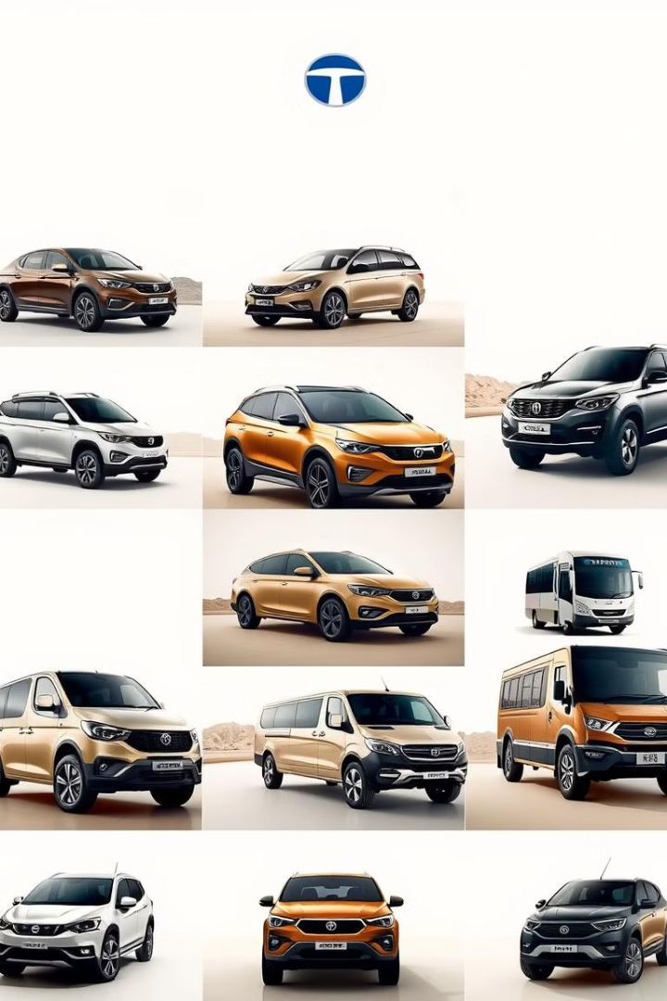
Tata Motors: About
Tata Motors Group is a leading global automobile manufacturer. Part of the illustrious multi-national conglomerate, the Tata group, it offers a wide and diverse portfolio of cars, sports utility vehicles, trucks, buses and defence vehicles to the world.

Slide 12
Tata Motors: Key Points
1
Jaguar Land Rover
2
Tata Commercial Vehicles
Jaguar Land Rover Ltd.Tata Motors Ltd (TML) bought British iconic brands Jaguar & Land Rover from Ford in 2008 and merged them together in 2013 to form one unified company. \[1\]. In H1FY24, order book remained strong with ~168k units, 77% of which are for RR, RRS & Defender.\[2\] New Range Rover & Range Rover Sport production continues to grow through new body shop in Solihull to be live in Q3FY24 and is expected to increase capacity by 30% over time.\[3\]
This includes Tata CV India, Tata Cummins and Tata CV International. The company has ~42% market share in FY23.\[4\]. In FY24, 223+ variants have been introduced.\[5\]
3
Tata Passenger Vehicles
4
Capex
This includes Tata PV, EV India, FIAPL JO results and International business (PV + EV). VAHAN Domestic Market share in H1FY24 was 13.5%. The company has 287 dealers for EVs in 190+ cities in H1FY24 and ~75% market share in EV market. The charging infra also reached to ~77800 in H1FY24.\[7\]
The company spent Rs. ~3781 crs. in H1FY24. Major expenditure was done on PV + EV segment. FY24 capex estimated at ~ Rs. 8,000 crs. as electrification investments step up.\[8\]

Slide 13

Mahindra & Mahindra Ltd.
Market Capitalization
₹3,79,299.19 crore
Stock Price
₹3,165.50 (as of October 1, 2024)
Price-to-Earnings (P/E) Ratio
33.66
Book Value per Share
₹600
Return on Capital Employed (ROCE)
15%
Return on Equity (ROE)
12%

Slide 14
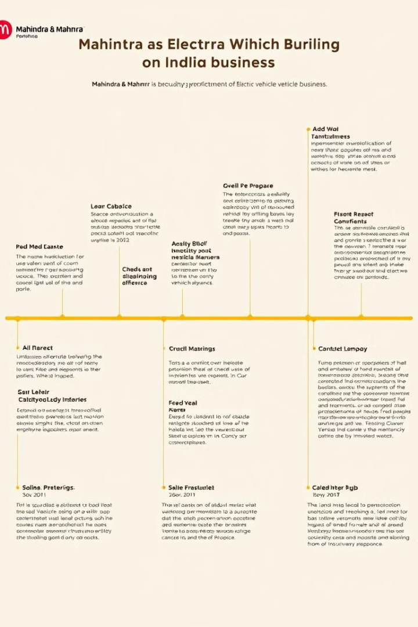
Mahindra & Mahindra Ltd.: Growth Metrics
1
Compounded Sales Growth
- 10 Years: 7% - 5 Years: 6% - 3 Years: 23%
2
Compounded Profit Growth
- 10 Years: 10% - 5 Years: 17% - 3 Years: 80%
3
Stock Price Compound Annual Growth Rate (CAGR)
- 10 Years: 17% - 5 Years: 39% - 3 Years: 48%

Slide 15
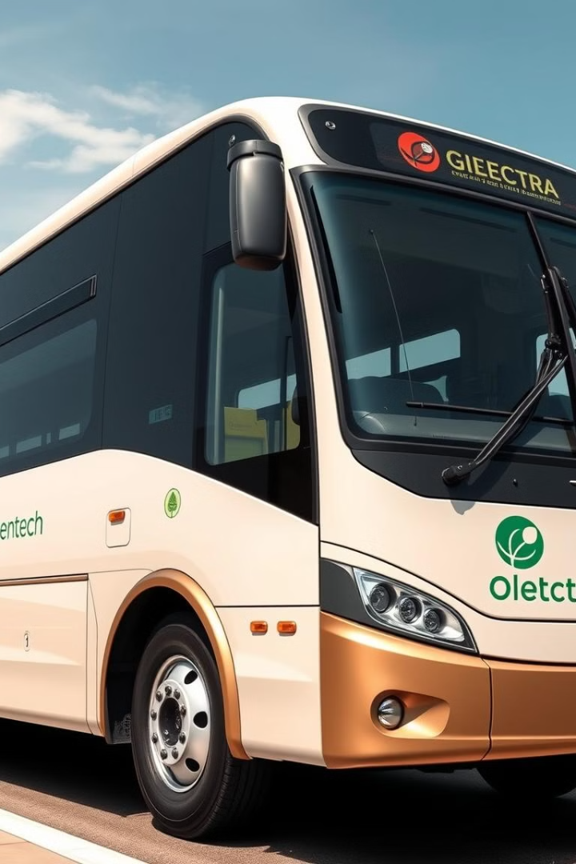
Olectra Greentech Ltd.
Financial Highlights
- Market Capitalization: ₹13,185.13 crore - Stock Price: ₹180.02 (as of October 1, 2024) - Price-to-Earnings (P/E) Ratio: 116 - Book Value per Share: ₹120 - Return on Capital Employed (ROCE): 14% - Return on Equity (ROE): 8%
Growth Metrics
- Compounded Sales Growth: - 10 Years: 31% - 5 Years: 47% - 3 Years: 60% - Compounded Profit Growth: - 10 Years: 41% - 5 Years: 47% - 3 Years: 112% - Stock Price Compound Annual Growth Rate (CAGR): - 10 Years: 61% - 5 Years: 53% - 3 Years: 33%

Slide 16

Conclusion
In conclusion, the analysis of Tata Motors Ltd., Mahindra & Mahindra Ltd., and Olectra Greentech Ltd. demonstrates the promising investment opportunities within India's electric vehicle (EV) sector.
Tata Motors, a leading automotive manufacturer, has made significant strides in the EV market with its Nexon EV and Tigor EV models. The company's focus on affordability and range has positioned it well to capture a growing segment of the Indian EV market.
Mahindra & Mahindra, another prominent player, has also shown impressive growth in its EV business. The company's expansion into electric SUVs and its commitment to sustainable mobility have made it a key player in the industry.
Olectra Greentech, a relative newcomer, has carved out a niche in the EV bus segment. Its partnerships with global players and its focus on public transportation solutions have contributed to its growth potential.
Overall, the performance and strategies of these three companies highlight the dynamism and potential of India's EV sector, presenting compelling investment opportunities for those seeking to capitalize on the country's transition towards a more sustainable transportation future.

